Slide 1
Linear Discriminant Analysis (LDA)

Slide 2
 Linear Discriminant Analysis, two classes
 Linear Discriminant Analysis, C classes
 LDA vs. PCA example
 Limitations of LDA
 Variants of LDA
 Other dimensionality reduction methods

Slide 3
Introduction
Linear Discriminant Analysis (LDA) is used to solve dimensionality reduction for data with higher attributes
Pre-processing step for pattern-classification and machine learning applications.
Used for feature extraction.
Linear transformation that maximize the separation between multiple classes.
“Supervised” - Prediction agent

Slide 4
Feature Subspace :
To reduce the dimensions of a d-dimensional data set by projecting it onto a (k)-dimensional subspace
(where k < d)
Feature space data is well represented?
Compute eigen vectors from dataset
Collect them in scatter matrix
Generate k-dimensional data from d-dimensional dataset.

Slide 5
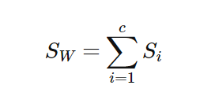
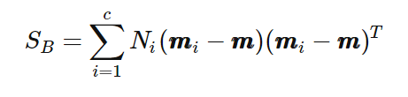
Scatter Matrix:
Within class scatter matrix
In between class scatter matrix
Maximize the between class measure & minimize the within class measure.

Slide 6
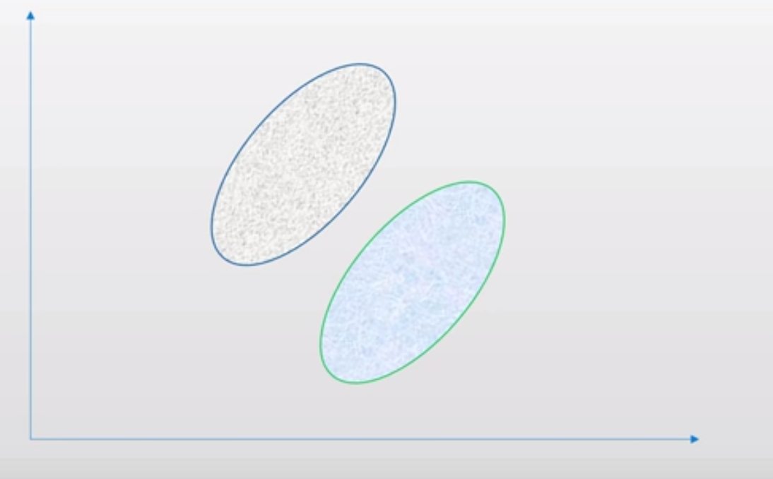

Slide 7
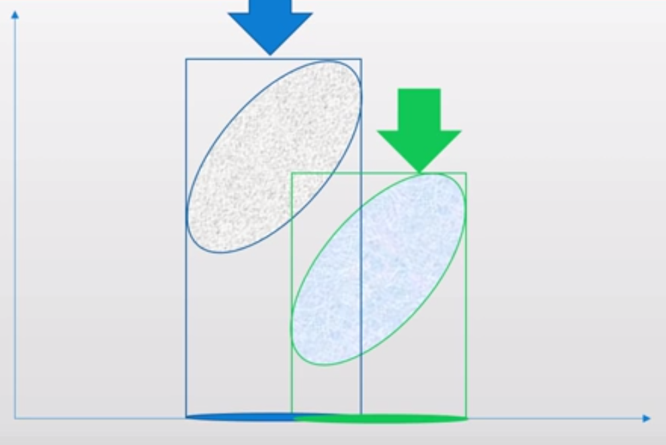

Slide 8
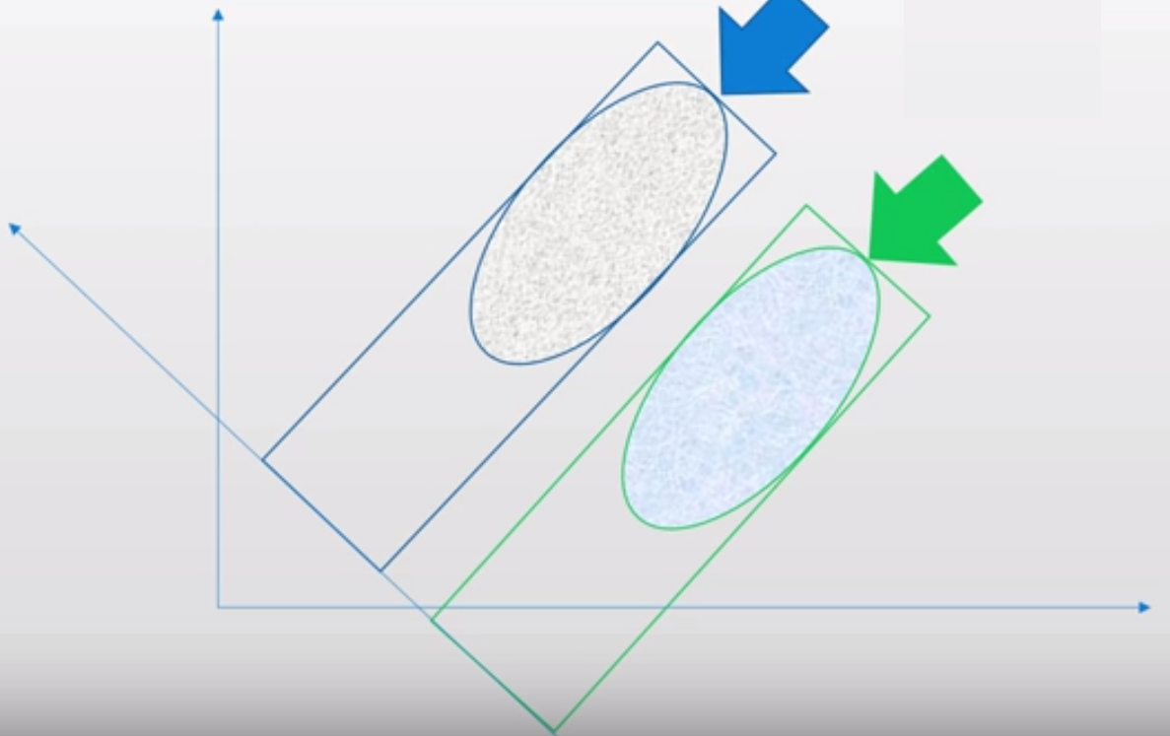

Slide 9
LDA steps:
Compute the d-dimensional mean vectors.
Compute the scatter matrices
Compute the eigenvectors and corresponding eigenvalues for the scatter matrices.
Sort the eigenvalues and choose those with the largest eigenvalues to form a d×k dimensional matrix
Transform the samples onto the new subspace.

Slide 10

Linear Discriminant Analysis, two-classes (1)
 The objective of LDA is to perform dimensionality reduction while preserving as much of the class discriminatory information as possible
■ Assume we have a set of D-dimensional samples {x⁽¹, x⁽², …, x^{(N}}, N₁ of which belong to class ω₁, and N₂ to class ω₂. We seek to obtain a scalar y by projecting the samples x onto a line
y = w ^{T} x
■ Of all the possible lines we would like to select the one that maximizes the separability of the scalars
 This is illustrated for the two-dimensional case in the following figures
x₂ x₂
x₁
x₁

Slide 11
Linear Discriminant Analysis, two-classes (2)
 In order to find a good projection vector, we need to define a measure of separation between the projections
 The mean vector of each class in x and y feature space is
µ = ¹ ∑x and µ =
1 1
~
∑ ∑
T T
i
i
y = w x = w µ
N
N N
i
i x∈ω_{i} i y∈ω_{i} i x∈ω_{i}
 We could then choose the distance between the projected means as our objective function
w (µ −µ )
J(w) = µ~ − µ~ =
1 2
T
1 2
 However, the distance between the projected means is not a very good measure since it does not take into account the standard deviation within the classes
x₂
μ₁
This axis yields better class separability
μ₂
x₁
This axis has a larger distance between means
11

Slide 12
Linear Discriminant Analysis, two-classes (3)
 The solution proposed by Fisher is to maximize a function that represents the difference between the means, normalized by a measure of the within-class scatter
■ For each class we define the scatter, an equivalent of the variance, as
s = (y − µ )
~
i ∑
~
2
2
i
y∈ω_{i}
 where the quantity (s + s ) is called the within-class scatter of the projected examples
~ ~
2 2
1 2
■ The Fisher linear discriminant is defined as the linear function w^{T}x that maximizes the criterion function
~ ~
2
2
J(w) = ^{µ1 − µ}
~ ~
2 2
1 2
s + s
■ Therefore, we will be looking for a projection where examples from the same class are projected very close to each other and, at the same time, the projected means are as farther apart as possible
x₂
μ₁
μ
2
x₁

Slide 13
Linear Discriminant Analysis, two-classes (4)
■ In order to find the optimum projection w*, we need to express J(w) as an explicit function of w
■ We define a measure of the scatter in multivariate feature space x, which are scatter matrices
S = (x − µ )(
x − µ )
i ∑
T
x∈ω_{i}
S₁ + S₂ = S_{W}
i
i
 where S_{W} is called the within-class scatter matrix
■ The scatter of the projection y can then be expressed as a function of the scatter matrix in feature space x
s = (y − µ )
= (w x − w µ ) = w (
~
i ∑
~
∑
x∈ω_{i}
i ∑
x − µ )(x − µ ) w = w S w
2
2
T T
2
T
T
T
y∈ω_{i}
i
x∈ω_{i}
i i i
~ ~
2 2
T
s + s = w S w
1 2 W
■ Similarly, the difference between the projected means can be expressed in terms of the means in the original feature space
~
− µ ) = (w µ − w µ ) =
(µ
~
2
2
w (µ −µ )(µ −µ ) w = w S w
T T
T
T
T
1 2
1 2
1¹4 4² 24¹ 44²3
B
S_{B}
 The matrix S_{B} is called the between-class scatter. Note that, since S_{B} is the outer product of two vectors, its rank is at most one
■ We can finally express the Fisher criterion in terms of S_{W} and S_{B} as
w ^{T}S w
J(w) = ^{B}
w ^{T}S w
W

Slide 14
Linear Discriminant Analysis, two-classes (5)
■ To find the maximum of J(w) we derive and equate to zero
d [
d ⎡ w ^{T}S w ⎤
B ₌
J(w)] =
dw
⎢ _{w} ⎥
0 ⇒
T
dw w S
⎣ W ⎦
⇒ [w S w]
W
d[w S w]
[w S w
B
]d[w ^{T}S w] ₌
W
T
T
B
T
0 ⇒
dw
dw
⇒ [w ^{T}S w]
2S w − [w S w]
W
T
2S w = 0
B B
W
■ Dividing by w^{T}S_{W}w
[w ^{T}S w]
[w S w]
]S_{W} w = 0 ⇒
W
S w −
T
B
[w S w]
W
B
[w S w
W
T
T
⇒ S_{B}w − JS_{W} w = 0 ⇒
⇒ S⁻¹S w − Jw = 0
W B
■ Solving the generalized eigenvalue problem (S_{W}⁻¹S_{B}w=Jw) yields
⎧
T
⎫
w* = argmax ⎨
w S w
= S⁻¹ µ
( −µ )
B
⎬
W 1 2
w ⎩w ^{T}S w ⎭
W
 This is know as Fisher’s Linear Discriminant (1936), although it is not a discriminant but rather a specific choice of direction for the projection of the data down to one dimension

Slide 15
LDA example
 Compute the Linear Discriminant projection for the following two-dimensional dataset
■ X1=(x₁,x₂)={(4,1),(2,4),(2,3),(3,6),(4,4)}
■ X2=(x₁,x₂)={(9,10),(6,8),(9,5),(8,7),(10,8)}
 SOLUTION (by hand)
■ The class statistics are:
10
8
6
x₂
⎡ 0.80 - 0.40⎤ ⎡ 1.84 - 0.04⎤
4
S =
⎢ ⎥
; S =
⎢
1
- 0.40 2.60
2
- 0.04 2.64 ⎥
⎣ ⎦
⎣
⎦
µ = [3.00 3.60];
µ = [8.40 7.60]
2
w
DA
1 2
L
■ The within- and between-class scatter are
0
₌ ⎡29.16 21.60⎤ ⎡ 2.64 - 0.44⎤
0
2
4
x₁
6
8
10
S
; S =
B
⎥ ⎢
W
⎢21.60 16.00 - 0.44 5.28 ⎥
⎣ ⎦ ⎣ ⎦
■ The LDA projection is then obtained as the solution of the generalized eigenvalue problem
_{− λI = 0 ⇒} 11.89 - λ
8.81
5.08 3.76 - λ
S⁻¹ S v = λv ⇒ S⁻¹ S
W B W B
= 0 ⇒ λ = 15.65
⎡11.89 8.81⎤⎡v₁ ⎤ _{= 15.65}⎡v₁ ⎤ ⇒ ⎡v₁ ⎤ ₌ ⎡0.91⎤
⎢ 5.08 3.76⎥⎢v ⎥
⎣ ⎦⎣ 2 ⎦
■ Or directly by
⎢_{v} ⎥ ⎢_{v} ⎥
⎢0.39⎥
⎣ 2 ⎦ ⎣ 2 ⎦ ⎣ ⎦
w* = S (µ −µ ) = [− 0.91 − 0.39]^{T}
−1
W 1 2

Slide 16
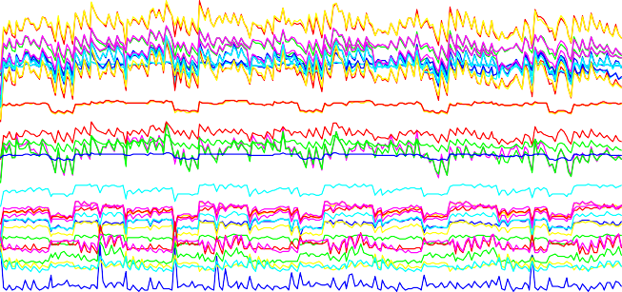

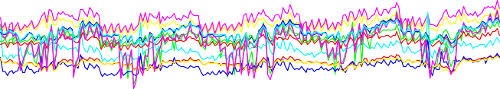

LDA Vs. PCA: Coffee discrimination with a gas sensor array
 These figures show the performance of PCA and LDA on an odor recognition problem
■ Five types of coffee beans were presented to an array of chemical gas sensors
■ For each coffee type, 45 “sniffs” were performed and the response of the gas sensor array was processed in order to obtain a 60-dimensional feature vector
 Results
60
40
Sensor response
20
0
■ From the 3D scatter plots it is clear that LDA outperforms PCA in terms of class discrimination
■ This is one example where the discriminatory information is not aligned with the direction of maximum variance
PCA
-20
-40
0
Sulaw esy
50
Kenya
100
Arabian
LDA
150
Sumatra
200
Colombia
²3 1
1
2 1₃4
₁11
1
5
5
5
35
₄ 23
₃233₁₁3₄5₄
₁ ₃1₃ 1 ₁₁
5
5
3² 4² 1⁵5
7.42
¹¹31¹¹1¹
1
5
5
5
5
3
₁14223₄34²₃141²⁴1³54¹⁵25
1¹³313¹1¹131
⁵55
2
2
2
2
₅52₁₃23₁2₃₁₄3₂4₅4₂₅₁31₅3
4
3³3₃¹13¹13 14
5
5⁵⁵555⁵
30
¹ 5541452442₂₃₁²3₁²1²3₄22 ₄₁
7.4
3333¹33313
5 555 ₅5
35 ₅ 1
1₂₁34₃5₃₄₅₄₁₃3₄2₁₄
3 ³¹3¹331 3
⁴4 4 4
₅ 55 ⁵ ₅5⁵5
5₅ 5
5 1
4
⁵⁵ ⁵1534541₅⁴5 5
₃3 3
3 4 4₄4
555₅
5
25
3
2 1
4 ₄₂
₃4₅35 4
7.38
3
3
333⁴ 4 44
4
4
2 2
2
axis 3
2₅1 ₄⁴₂13
23₄3₁₄
5
axis 3
3₃
444 4 4
₂2₂2 2 52
3 3 ⁵⁴ ³5¹⁴2
51¹ 51
52 ₁
7.36
4 44 4⁴
4
₂₂ 2222₂
20
3
2
₄44
4
2
2₂ 2₂
3 3
5
4
₂2 2
21³
1
5 5
7.34
4
4
2₂2
22
15
₄ 44
2
2 2 2
100
7.32
2 2
2
0.4
10
5
2
-260
2
90
-1.96
0.35
-240
-220
80
-1.94
-1.92
-1.9
-200
70
axis 2
-1.88
0.3
axis 2
axis 1
axis 1

Slide 17
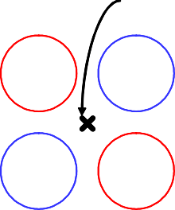
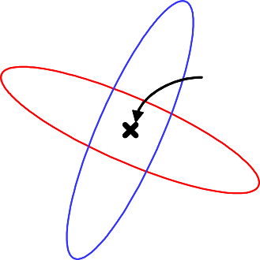
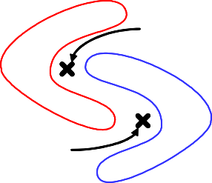
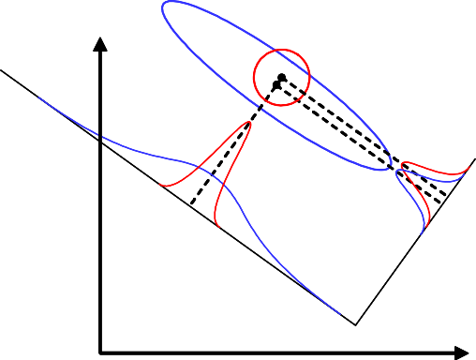
Limitations of LDA
 LDA produces at most C-1 feature projections
■ If the classification error estimates establish that more features are needed, some other method must be employed to provide those additional features
 LDA is a parametric method since it assumes unimodal Gaussian likelihoods
■ If the distributions are significantly non-Gaussian, the LDA projections will not be able to preserve any complex structure of the data, which may be needed for classification
μ₁=μ₂=μ
ω₂
ω
ω
μ₁
ω₁
μ₁=μ₂=μ
1
2
ω₁
ω
ω
ω₂
2
1
μ₂
 LDA will fail when the discriminatory information is not in the mean but rather in the variance of the data
x₂
PCA
LDA
x₁

Slide 18
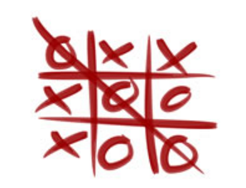
Dataset
Attributes :
X
O
Blank
Class:
Positive(Win for X)
Negative(Win for O)

Slide 19
Dataset
top-left-square | top-middle-square | top-right-square | middle-left-square | middle-middle-square | middle-right-square | bottom-left-square | bottom-middle-square | bottom-right-square | Class
x | x | x | x | o | o | x | o | o | positive
x | x | x | x | o | o | o | x | o | positive
x | x | x | x | o | o | o | o | x | positive
o | x | x | b | o | x | x | o | o | negative
o | x | x | b | o | x | o | x | o | negative
o | x | x | b | o | x | b | b | o | negative

Slide 20
Variants of LDA
 Non-parametric LDA (Fukunaga)
■ NPLDA removes the unimodal Gaussian assumption by computing the between-class scatter matrix S_{B} using local information and the K Nearest Neighbors rule. As a result of this
 The matrix S_{B} is full-rank, allowing us to extract more than (C-1) features
 The projections are able to preserve the structure of the data more closely
 Orthonormal LDA (Okada and Tomita)
■ OLDA computes projections that maximize the Fisher criterion and, at the same time, are pair-wise orthonormal
 The method used in OLDA combines the eigenvalue solution of S_{W}⁻¹S_{B} and the Gram-Schmidt orthonormalization procedure
 OLDA sequentially finds axes that maximize the Fisher criterion in the subspace orthogonal to all features already extracted
 OLDA is also capable of finding more than (C-1) features
 Generalized LDA (Lowe)
■ GLDA generalizes the Fisher criterion by incorporating a cost function similar to the one we used to compute the Bayes Risk
 The effect of this generalized criterion is an LDA projection with a structure that is biased by the cost function
 Classes with a higher cost C_{ij} will be placed further apart in the low-dimensional projection
 Multilayer Perceptrons (Webb and Lowe)
■ It has been shown that the hidden layers of multi-layer perceptrons (MLP) perform non-linear discriminant analysis by maximizing Tr[S_{B}S_{T}†], where the scatter matrices are measured at the output of the last hidden layer

Slide 21
Other dimensionality reduction methods (1)
 Exploratory Projection Pursuit (Friedman and Tukey)
■ EPP seeks an M-dimensional (M=2,3 typically) linear projection of the data that maximizes a measure of “interestingness”
■ Interestingness is measured as departure from multivariate normality
 This measure is not the variance and is commonly scale-free. In most proposals it is also affine invariant, so it does not depend on correlations between features . [Ripley, 1996]
■ In other words, EPP seeks projections that separate clusters as much as possible and keeps these clusters compact, a similar criterion as Fisher’s, but EPP does NOT use class labels
■ Once an interesting projection is found, it is important to remove the structure it reveals to allow other interesting views to be found more easily
UNINTERESTING
INTERESTING
x₂
x₂
x₁
x₁

Slide 22

Other dimensionality reduction methods (2)
 Sammon’s Non-linear Mapping (Sammon)
■ This method seeks a mapping onto an M-dimensional space that preserves the inter-point distances of the original N-dimensional space
 This is accomplished by minimizing the following objective function
[d(P,P ) − d(P ,P )]
2
E(d,d' ) = ∑
i≠ j
' '
i j i j
d(P_{i},P_{j} )
■ The original method did not obtain an explicit mapping but only a lookup table for the elements in the training set
■ Recent implementations using artificial neural networks (MLPs and RBFs) do provide an explicit mapping for test data and also consider cost functions (Neuroscale)
■ Sammon’s mapping is closely related to Multi-Dimensional Scaling (MDS), a family of multivariate statistical methods commonly used in the social sciences
x₂
x₂
P_{j}
P’_{j}
d(P_{i}, P_{j})= d(P’_{i}, P’_{j}) ∀ i,j
P’_{i}
P_{i}
x₁
x₃
x₁

Slide 23
References:
[1]https://en.wikipedia.org/wiki/Principal_component_analysis#
[2]http://sebastianraschka.com/Articles/2015_pca_in_3_steps.html#a-summary-of-the-pca-approach
[3]http://cs.fit.edu/~dmitra/ArtInt/ProjectPapers/PcaTutorial.pdf
[4] Sebastian Raschka, Linear Discriminant Analysis Bit by Bit, http://sebastianraschka.com/Articles/414_python_lda.html , 414.
[5] Zhihua Qiao, Lan Zhou and Jianhua Z. Huang, Effective Linear Discriminant Analysis for High Dimensional, Low Sample Size Data
[6] Tic Tac Toe Dataset - https://archive.ics.uci.edu/ml/datasets/Tic-Tac-Toe+Endgame

